Slide 1
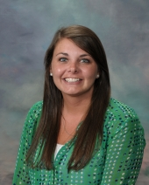
Ms. Pettis
Math Teacher
Room 105
(Main Hall)
BS Math Ed 2015
Gifted Endorsement 2018
MA Math Ed 2019
EdS Curriculum & Instruction 2021
I have been teaching since 2015
(All years at CHS)

Slide 2
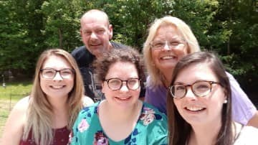
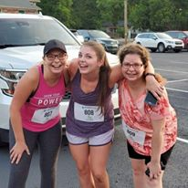
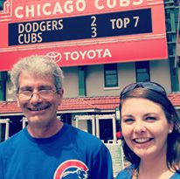
My Family
My sisters and I at the Backpack Buddies 5K
2019
My stepdad, mom, sisters, and I
2020
………………………………………….…
Dad – Dairy Manager for Kroger
Mom – Administrative Assistant for Kroger
Stepdad – Truck Driver for Southeastern Freight
Twin (Ashley) – Middle School Math Teacher
Little Sister (Amanda) – Dental Assistant
CAN YOU GUESS WHO MY TWIN IS??? ☺
Nantahala River Rafting 2021
My dad and I at
Wrigley Field 2018
CAN YOU GUESS WHO MY TWIN IS???

Slide 3
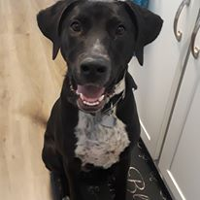
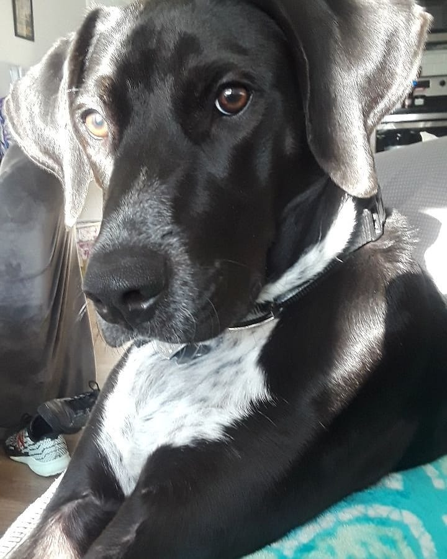
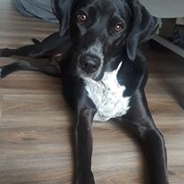
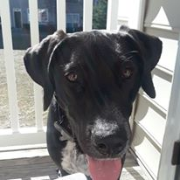
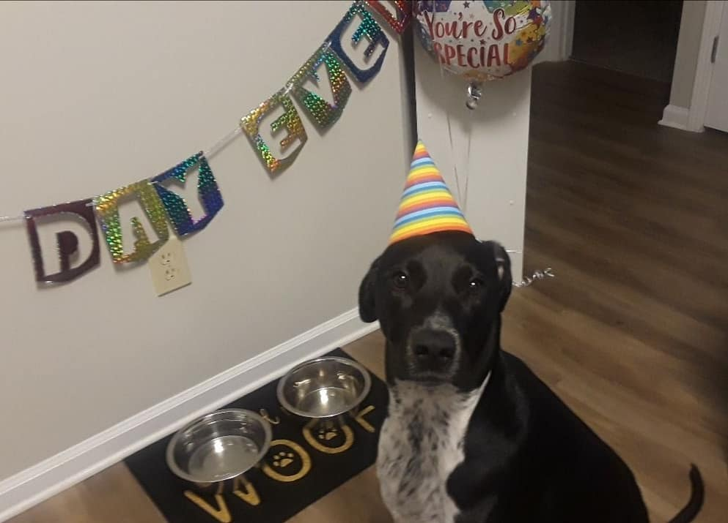
My Doggie: Charlie
Yes, I am that crazy dog mom who goes all out for Charlie’s “Gotcha Day!”
(He hated it by the way!)
Charlie is two years old, and he is struggling with me going back to work ☹

Slide 4
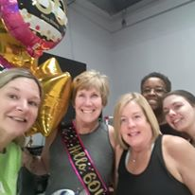
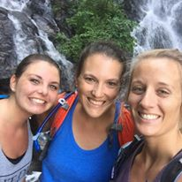
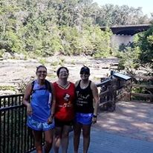
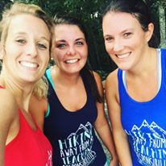
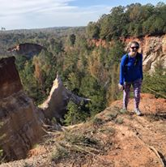
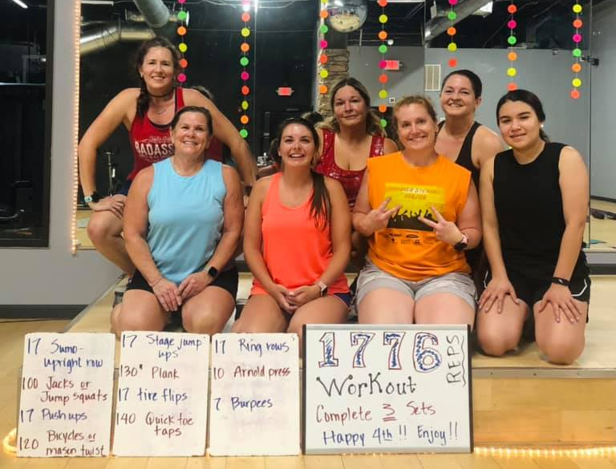
Hobbies
I wake up every morning at 4:30 AM to workout with these crazies! ☺
Hiking is my favorite activity, especially with my hiking buddies Mrs. Collier and Mrs. Chapman!

